Slide 1
Custom Metrics for a Python Based Application
Story#281

Slide 2
Story#281 Custom Metrics for a Python based Application
Developed a simple Python Web Application, which is of login page if we provide valid login credentials it will display login successful else if will display login failed.
Added hooks in particular areas of source code to pull the Metrics like, Total number of login requests, Successful requests and Failed Request along with duration for each request, source code is
Login page template file is ->
Containerised the Application to image “tvkrishna21/python-with-exporter:1.0.0”
Created Prometheus and Grafana to Scrape the metrics from the Application end point to Visualize the metrics.
Created Custom Dashboard Panels in Grafana, Dashboard panels json file ->

Slide 3
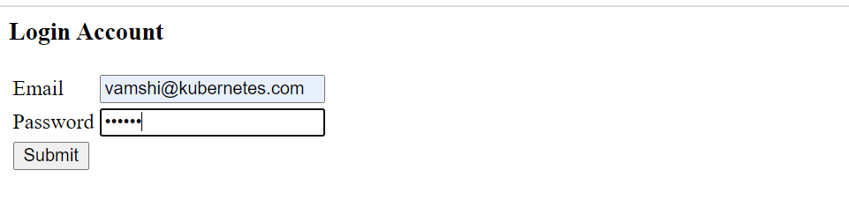
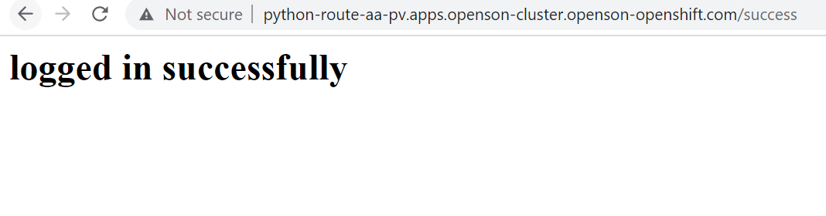
Login Page, Valid Credentials are Email is vamshi@kubernetes.com and password is vamshi.
For Valid credentials, it will display the below message.

Slide 4
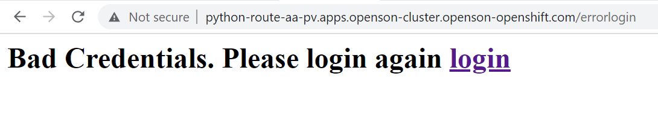
For Invalid Credentials, it will display the below message.

Slide 5
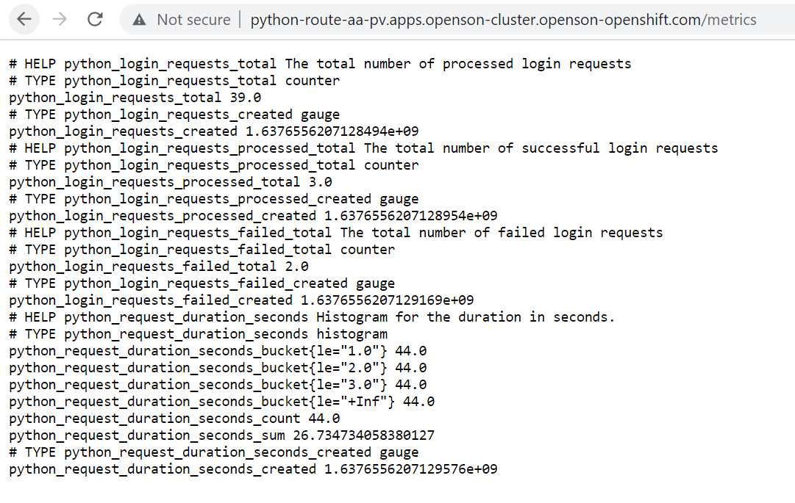
Custom metrics are at /metrics endpoint.

Slide 6
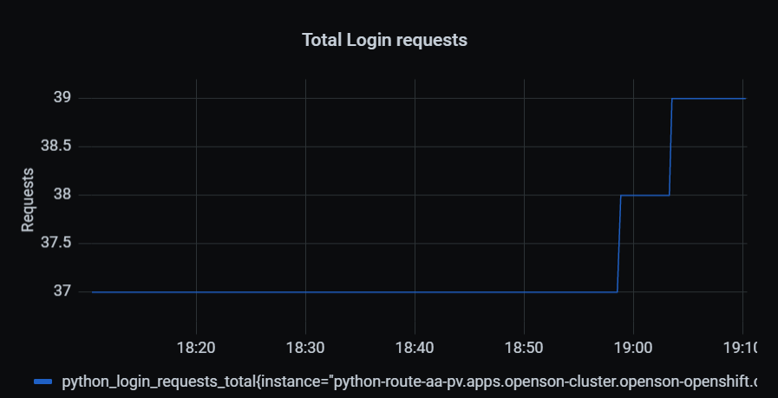
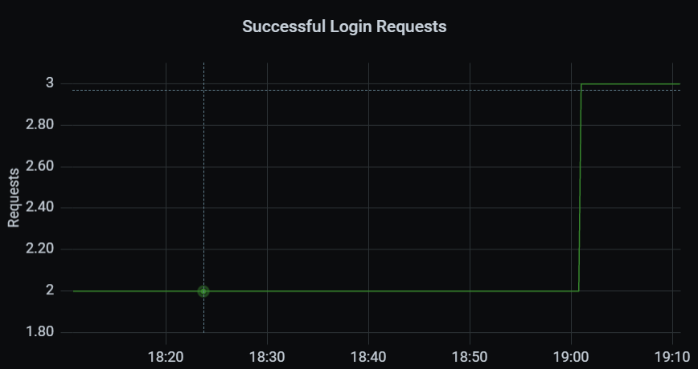
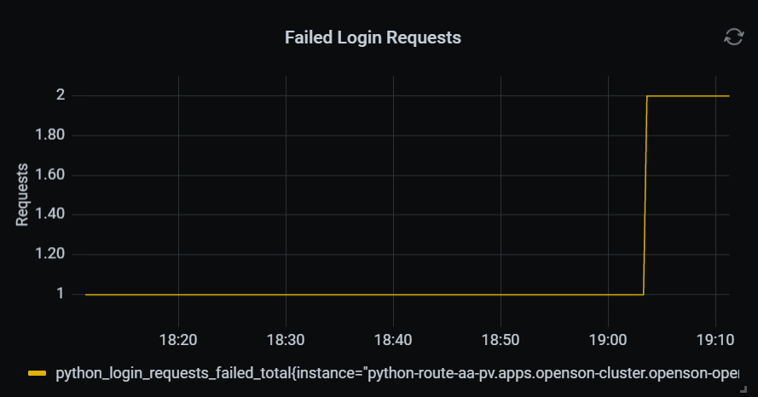
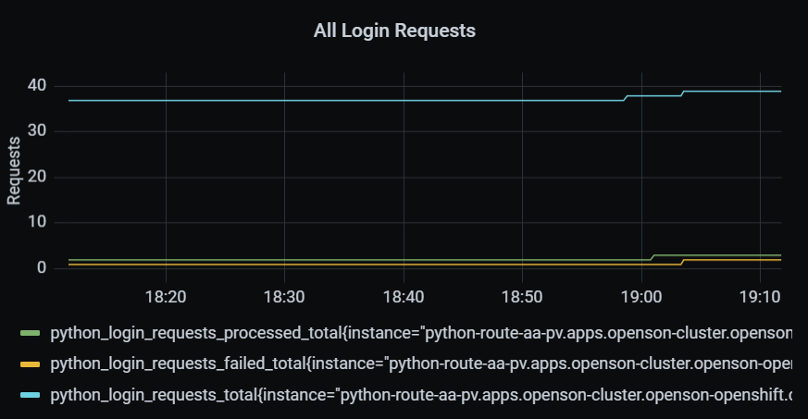
Grafana Dashboards Application Specific

Slide 7
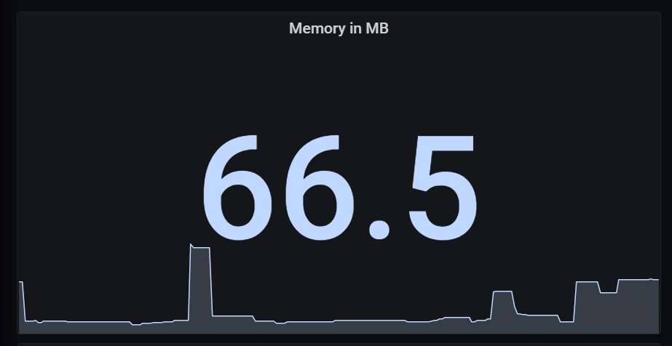
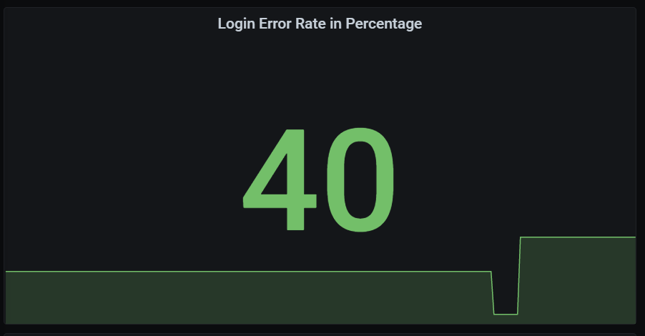
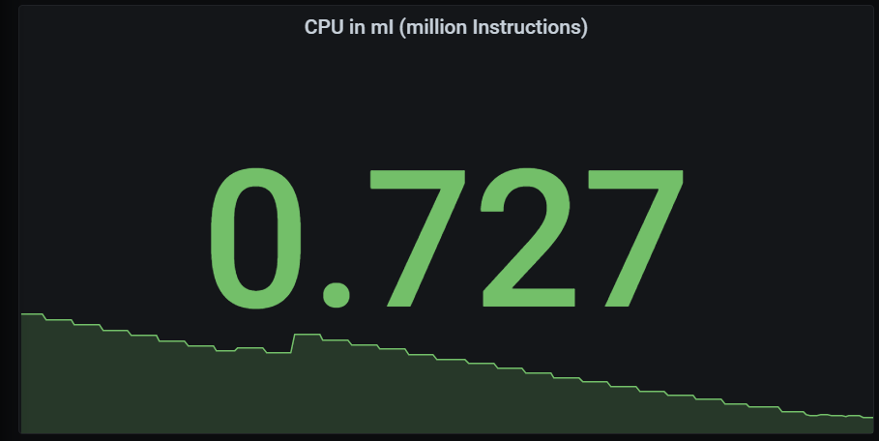
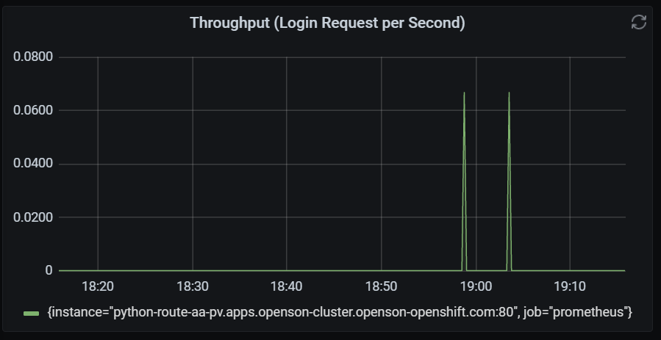
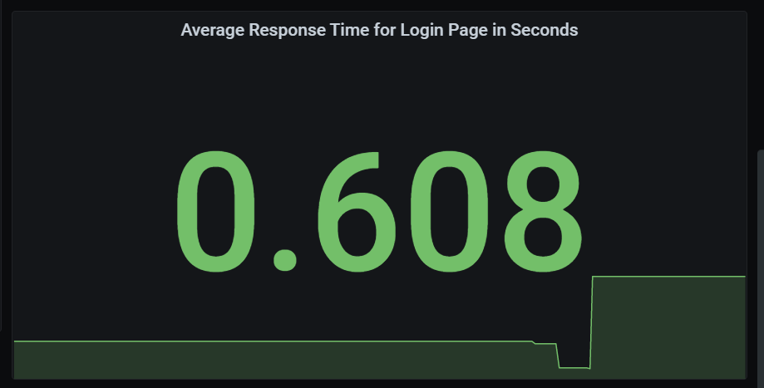
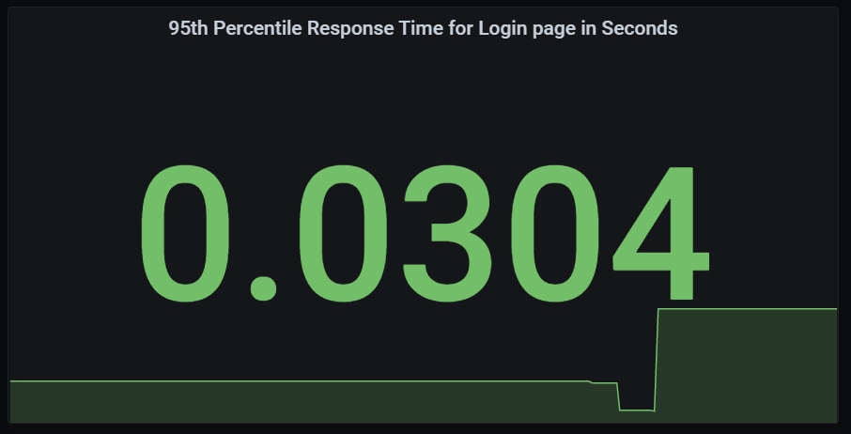
Grafana Dashboards

